Slide 1
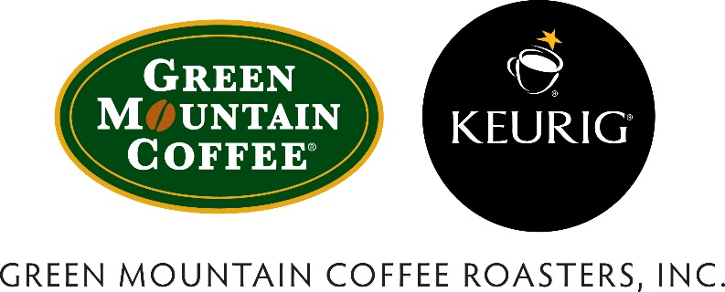
Green Mountain Coffee Roasters,Inc & Keurig Coffee
Daphne Fang
Jinny Kim
Carolyn Ku
Wan-Ching Lee

Slide 2
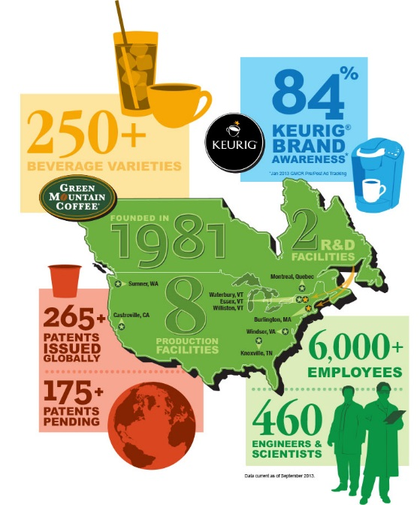
Company Overview
Vision/Purpose:
“We create the ultimate beverage experience in every life we touch from source to cup – transforming the way the world understands business.”
Mission:
“A Keurig brewer on every counter and a beverage for every occasion.”

Slide 3
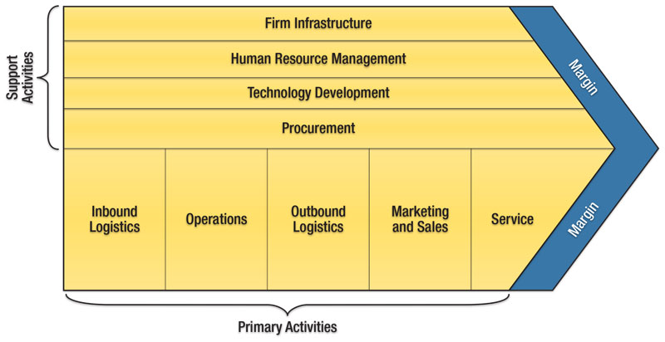
Value Chain Analysis
Primary Activities
Operations:
Nitrogen-flushed packaging enhances quality
Efficient processing and cultivation methods to roast coffee in small batches, ensure consistency
Marketing & Service:
Consumer trial/sampling through various channels of distribution
Superior customer service, ability to form relationships to improve business
Supporting Activities
Technology Development:
State of the art roasting software, nitrogen-flushed packaging
Procurement:
Collaborative “win-win” relationship with suppliers: Believes doing well financially can go hand in hand with giving back to the community and protecting the environment

Slide 4
Financial Analysis

Slide 5
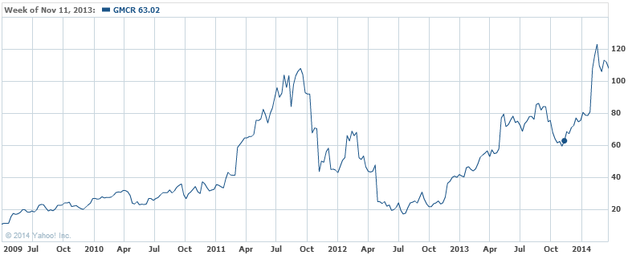
Stock Performance
Equity Snapshot
Price = $109.26 (as of 04/02/2014)
Beta = 0.30
Profit Margin (ttm) = 11.66%
ROA (ttm) = 14.05%
ROE (ttm) = 21.00%
Diluted EPS (ttm) = 3.37
Total Debt/Equity (mrq) = 10.15
Current Ratio (mrq) = 2.70

Slide 6
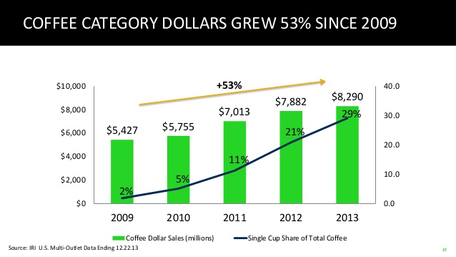
Macroeconomic Indicators

Slide 7
Porter’s Five Forces Model
Threat of Substitutes - Medium
Highly competitive market but first product of its kind; still holds patents on K-Cup filters
Competitive Rivalry - High
Expiration of K-Cup patents in 2012 have opened up competition into the growing market
Threat of New Entrants - Medium
Low entrance barriers to existing competitors; high entrance barriers to potentially new entrants
Buyer Power - Medium
Few on market offer similar product; patent expiration has allowed competitors to introduce competitive products
Supplier Power - High
Both supply and distribution from one entity in China

Slide 8
SWOT Analysis
Strengths | Weaknesses
Customer loyalty, strong brand recognition Leading market position built on strong product portfolio Reaches a wide consumer base through a variety of products and flavor options | Reliance on single entity for both supply and distribution Lacks on online presence
Opportunities | Threats
Partnerships (domestic and international) to broaden consumer base and increase consumer choice Launched several new products to address all occasions and uses Growing market as popularity of single-serve coffee systems increases | Decreased availability of Arabica coffee beans Intense competition in specialty coffee market Patent for K-cups expired in 2012, no ability to patent actual single-serving system Labeled as “organic” and must meet all government regulations

Slide 9
VRIO Analysis
Implications:
Keurig holds a very strong and wholesome reputation for being organic and innovative
While the specialty coffee market has attempted to duplicate similar design of the single-serve Keurig system, it has become somewhat of a household name
Resource or Capability | Value | Rarity | Imitability | Organization
Reputation | Yes | No | No | Yes
Product | Yes | No | No | Yes
Innovation/R&D | Yes | Yes | Yes | Yes
Convenience | Yes | Yes | No | Yes
But Keurig is at a disadvantage in finances against companies like Starbucks who already have the reputation in physical locations
Their innovate idea is at jeopardy if Keurig does not continue to produce new products ahead of its competitors.

Slide 10
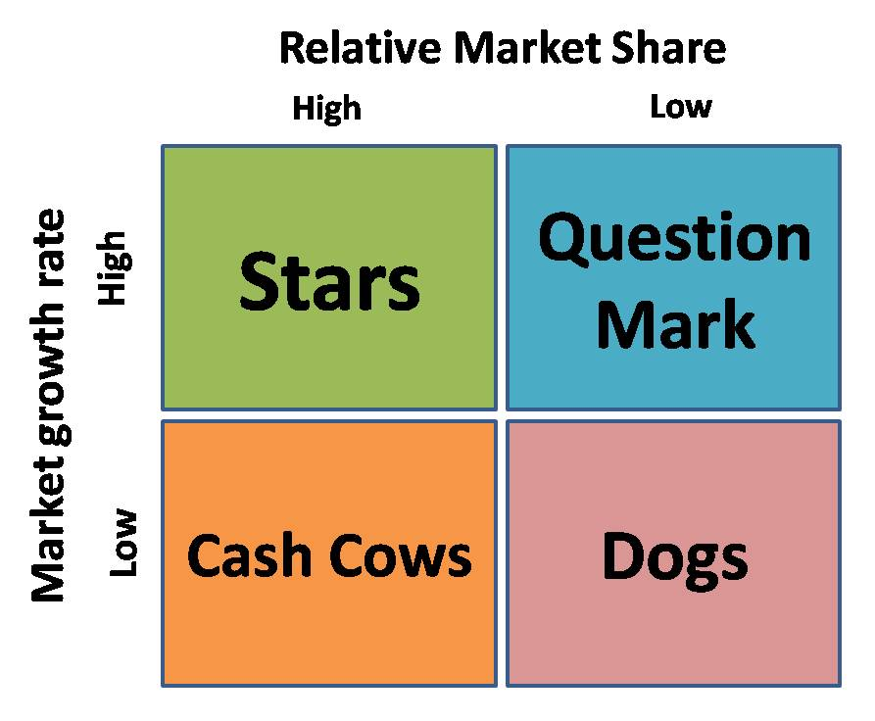
BCG Portfolio Matrix
Stars:
Hold high market share in a fast-growing industry
Require high funding to fight competitors
Must remain a niche leader or amongst market leaders to become cash cows when industry growth slows

Slide 11
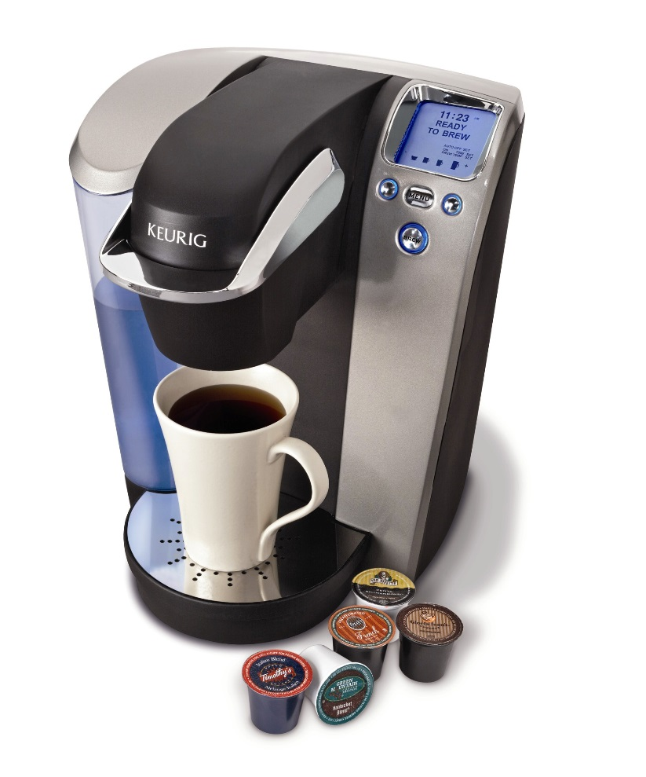
Three Generic Strategies Types of Diversification
Partners, Alliances, and Acquisitions
Partners: Green Mountain Coffee Roasters, Cinnabon, Lipton, Snapple
Alliances: Dunkin Donuts, Starbucks, Folger’s
Acquisitions: Green Mountain Coffee
Product Diversification
Sell 27 brands and over 200 types of coffee, cocoa, teas, and other beverages in K-cups
Specialty whole beans and grounded coffee
Multi-Channel Distribution
Widespread exposure to brand in a variety of settings
Ease of access to the product
Many tasting opportunities for consumers

Slide 12
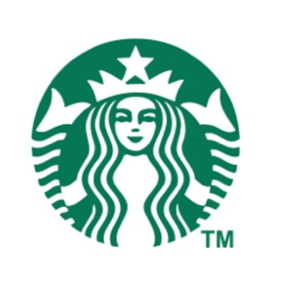
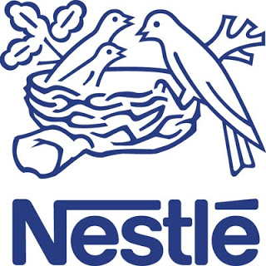
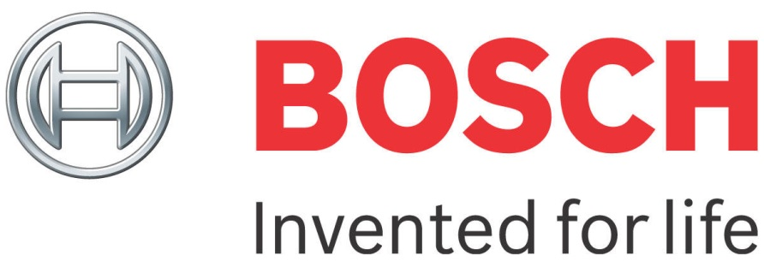
Key Rivals
Starbucks – “Verismo”
Product Differentiation
Joint ventures, strategic alliances, and acquisitions
Globalization
Nestle – “Nespresso” & “NesCafe”
Low cost, high efficient operations
Renovation and innovation
Globalization
Bosch – “Tassimo”
Technological competence
Innovation
Globalization

Slide 13
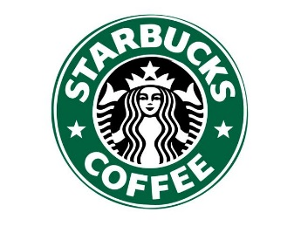
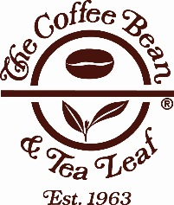
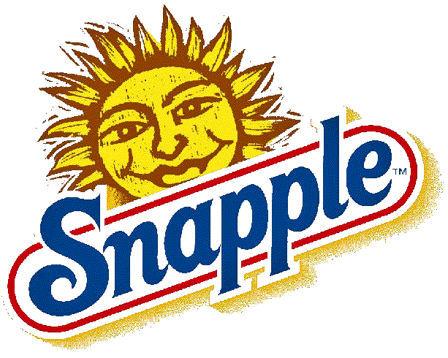
Acquisitions & Joint Ventures
Acquisitions:
2006 – Green Mountain Coffee acquires Keurig to create Green Mountain Coffee Roasters, Inc
2010 – Keurig acquired LJVH Holdings, Inc, owner of Van Houtte based in Quebec, Canada
Divestitures:
2011 – GMCR sold Van Houtte U.S. Coffee Services or “Filterfresh” to ARAMARK Refreshment Services, LLC in 2011
Joint Ventures:
Dunkin Donuts, Seattle’s Best Coffee, Starbucks, The Coffee Bean & Tea Leaf, Cinnabon, Tazo, Snapple, Kirkland Signature, and others

Slide 14
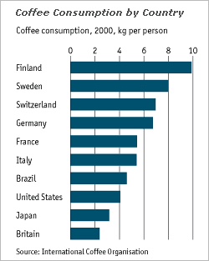
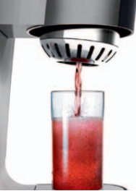
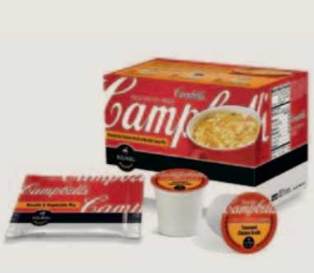
Recommendations
Industry Expansion
Create partnerships that allow related diversification into other markets
Open up physical locations
Innovate machinery and incorporate premium coffee, such as espresso
Go Global
Expand internationally, go overseas into global markets
Extend brand recognition beyond North America
Stock Recommendation : HOLD

Slide 15
Questions?

